Slide 1
Automated Question Paper Generation System Using Randomization.
ALBY JOSE IIIrd BCA

Slide 2
Abstract
Purpose: To simplify and automate the manual process of creating examination papers.
Core Function: Automatically selects questions randomly from a stored question bank based on specific criteria.
Technology: Developed as a web-based application using Ruby on Rails and PostgreSQL.
Impact: Reduces manual work, ensures fairness, and prevents question repetition.

Slide 3
Existing System (The Problem)
Manual Preparation: Teachers manually select questions from textbooks and notes.
Time Consuming: Requires significant time and effort to prepare each paper.
Human Error: High possibility of repeating questions or making mistakes.
Security Risk: Manual handling increases the risk of paper leakage.

Slide 4
Proposed System (The Solution)
Automation: Automatically generates papers using a stored question bank.
Randomization: Uses a Shuffle Algorithm for unbiased question selection.
Categorization: Questions are organized by subject, unit, and difficulty level.
Efficiency: Saves time for teachers and ensures better security.

Slide 5
System Architecture
Architecture: Follows a Three-Tier Architecture (Client, Application, and Database layers).
Front End: HTML, CSS, JavaScript, and Tailwind.
Back End: Ruby on Rails (MVC Framework).
Database: PostgreSQL for secure data storage.

Slide 6
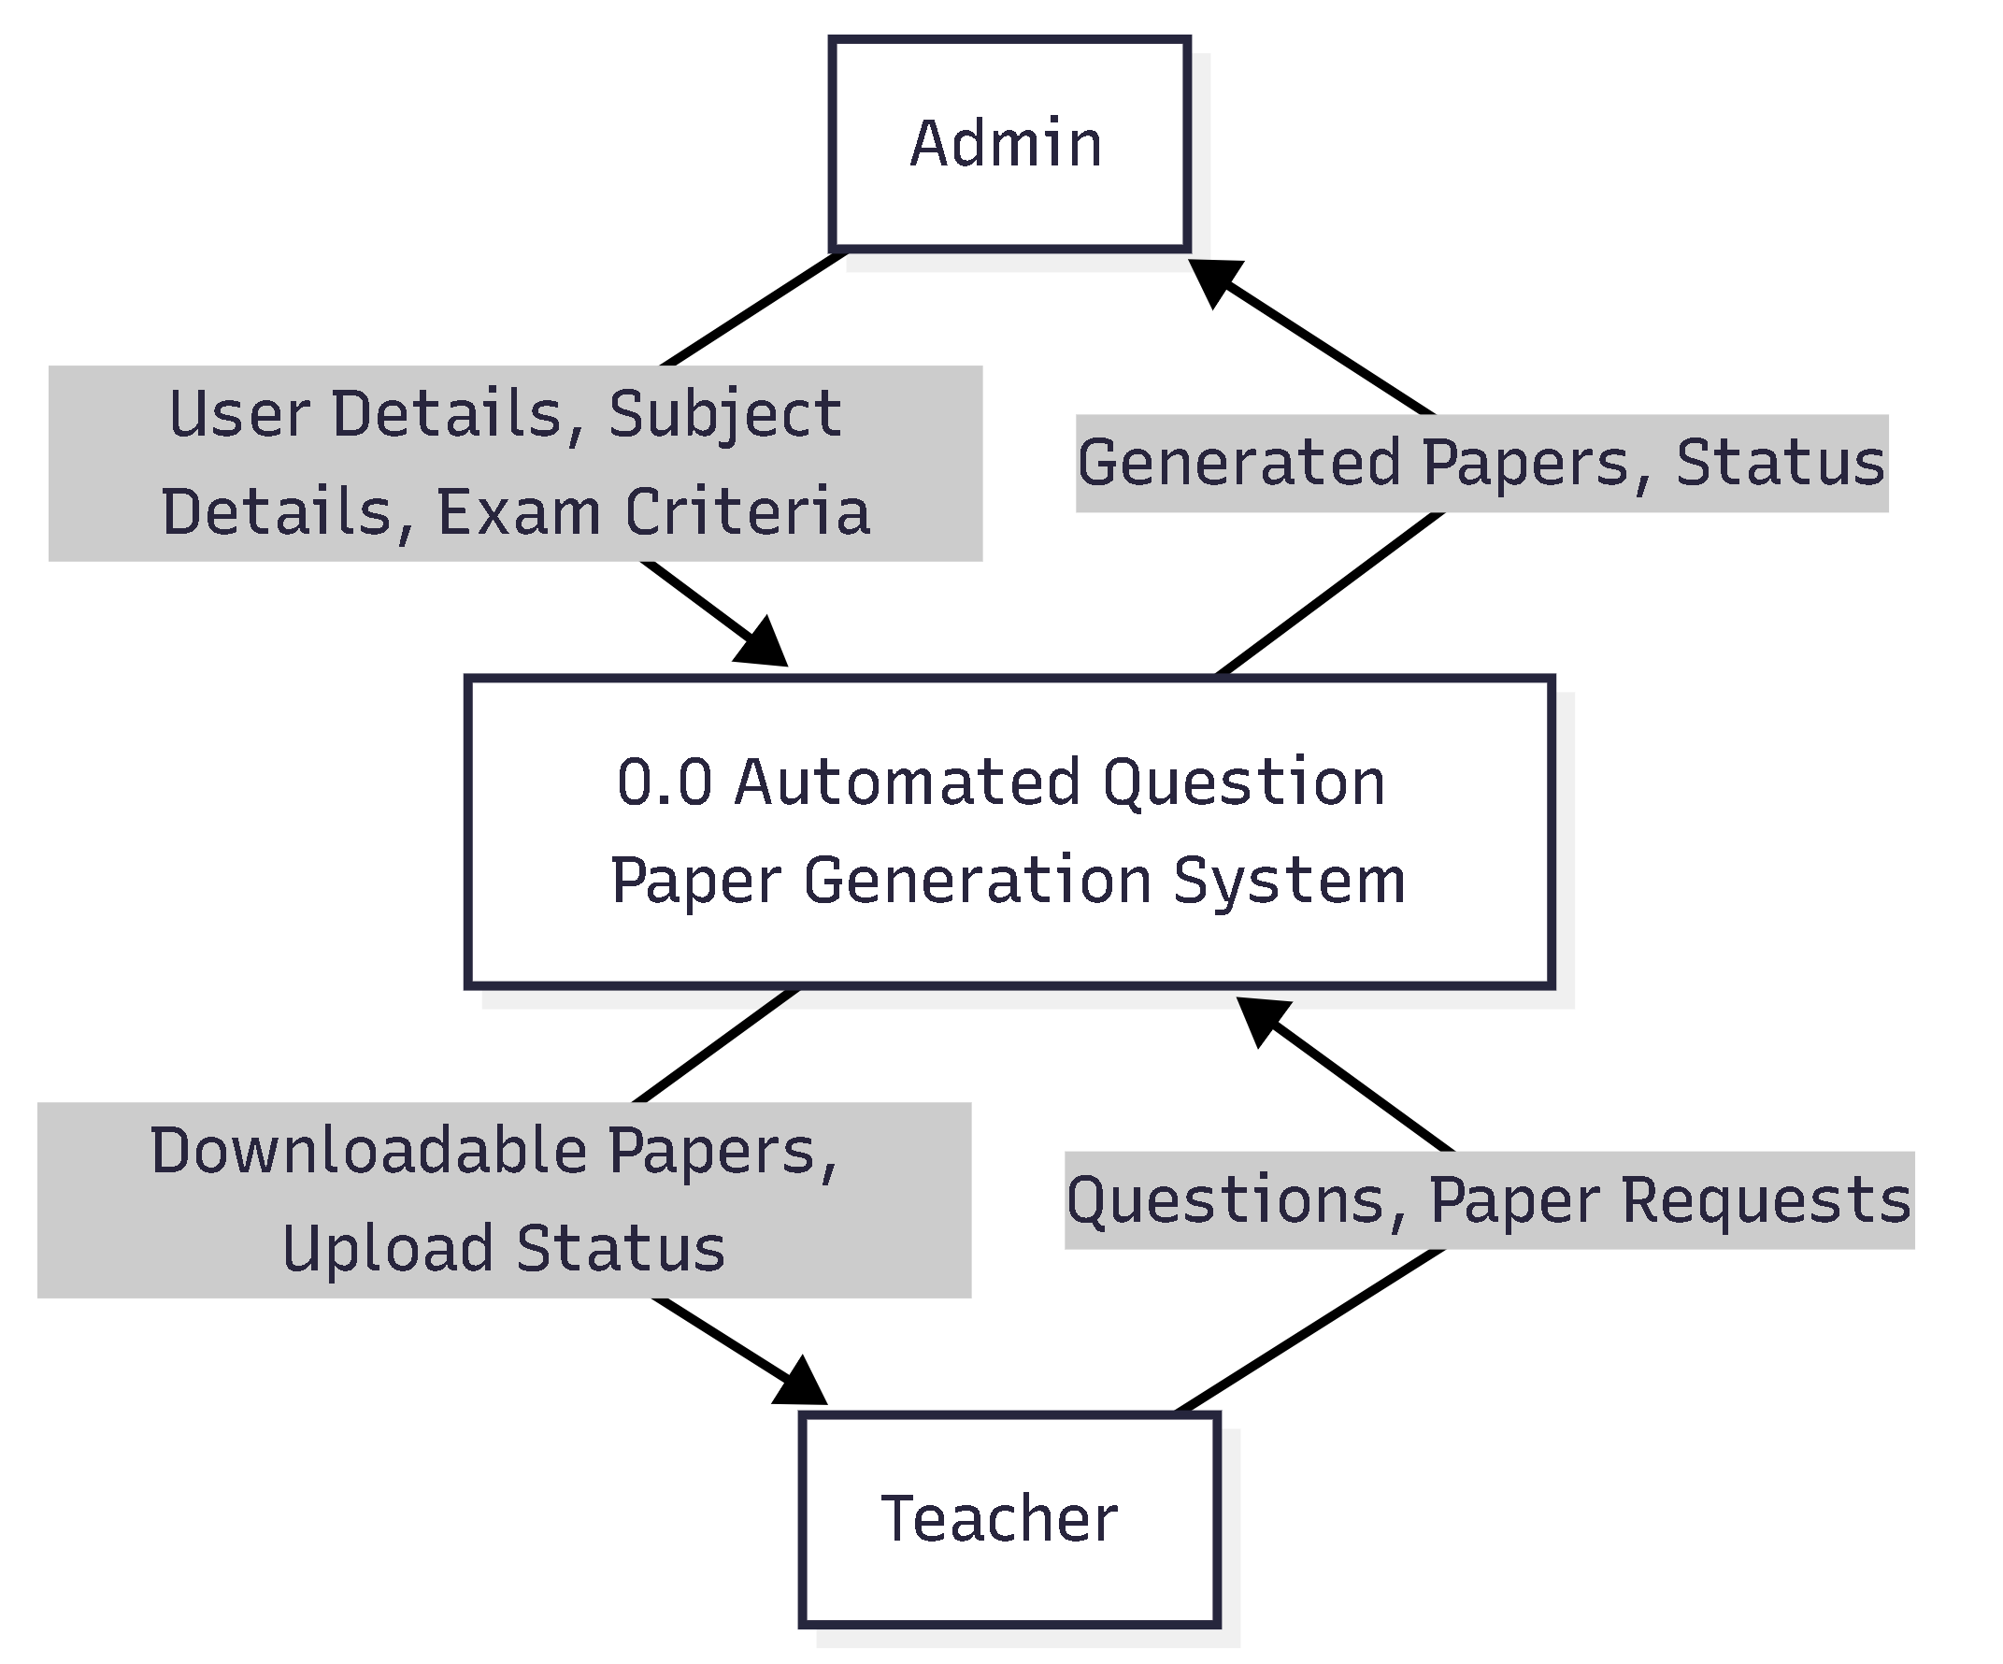
Data Flow Diagram (Context & Level 0)

Slide 7
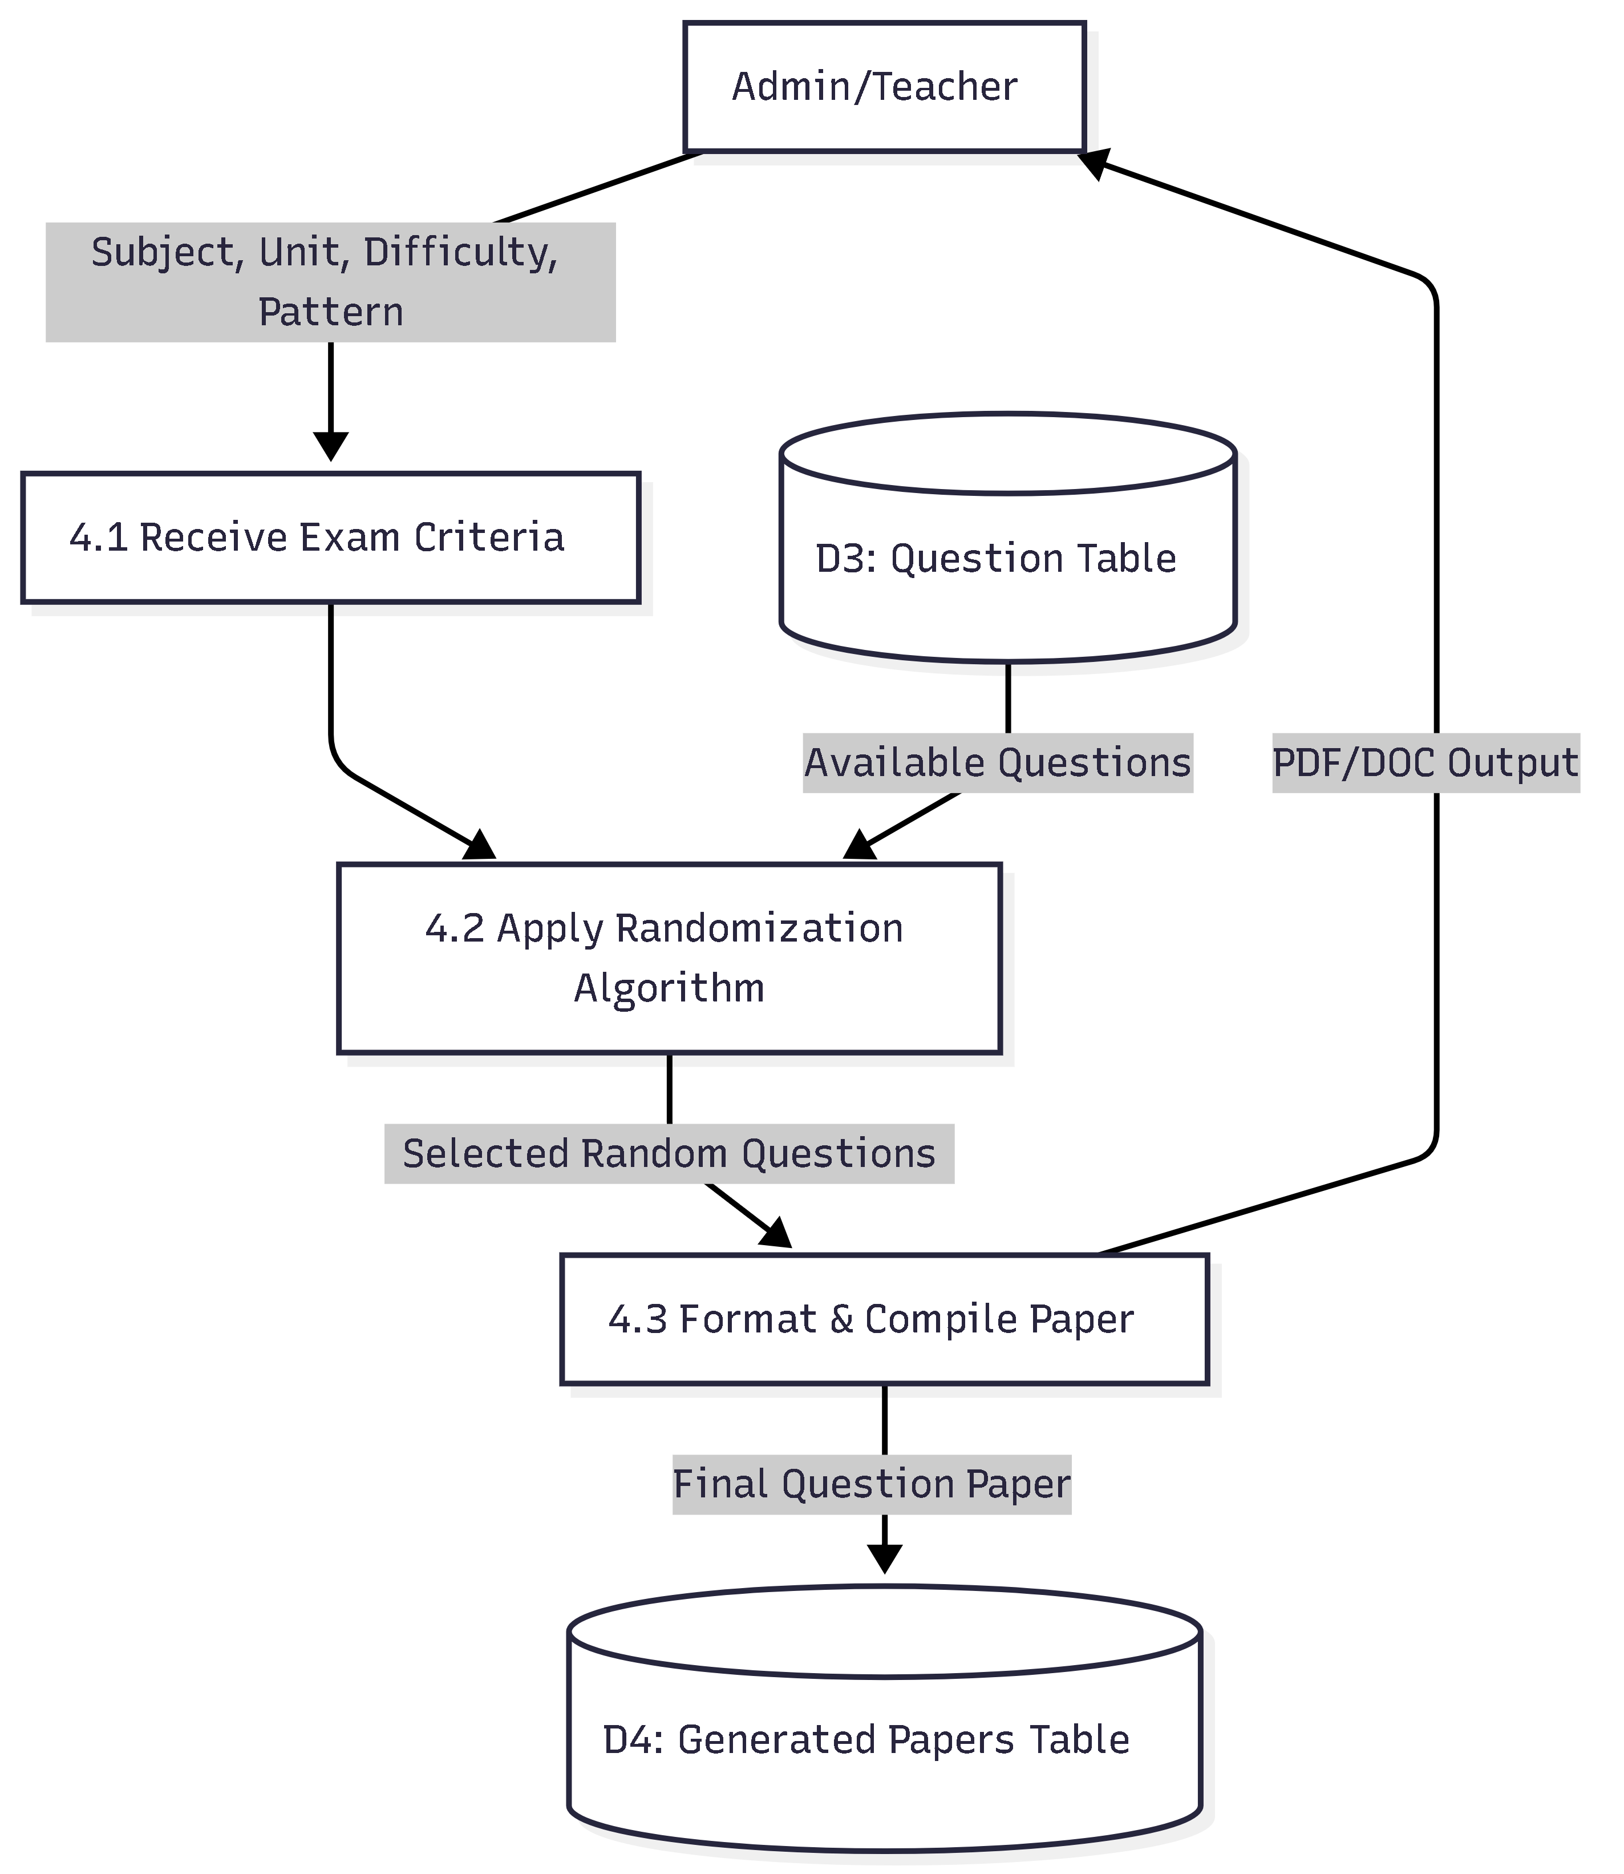
Data Flow Diagram (Level 1 - Randomization)

Slide 8
Database Table Design
tbl_users: Stores Admin and Teacher login details.
tbl_subjects: Manages subject names and unique codes.
tbl_questions: Stores the actual question bank with difficulty levels.
tbl_exam_papers: Stores metadata of every generated paper.
tbl_paper_questions: Maps specific questions to specific papers.

Slide 9
Current Progress (50% Completion)
Completed: Database Schema, System Design (DFDs), and Abstract.
Form Designs: Login screens, Subject Management, and Question Entry forms are ready.
Next Phase: Integration of the Shuffle Algorithm and PDF export functionality.

Slide 10
Thank you

